Slide 1

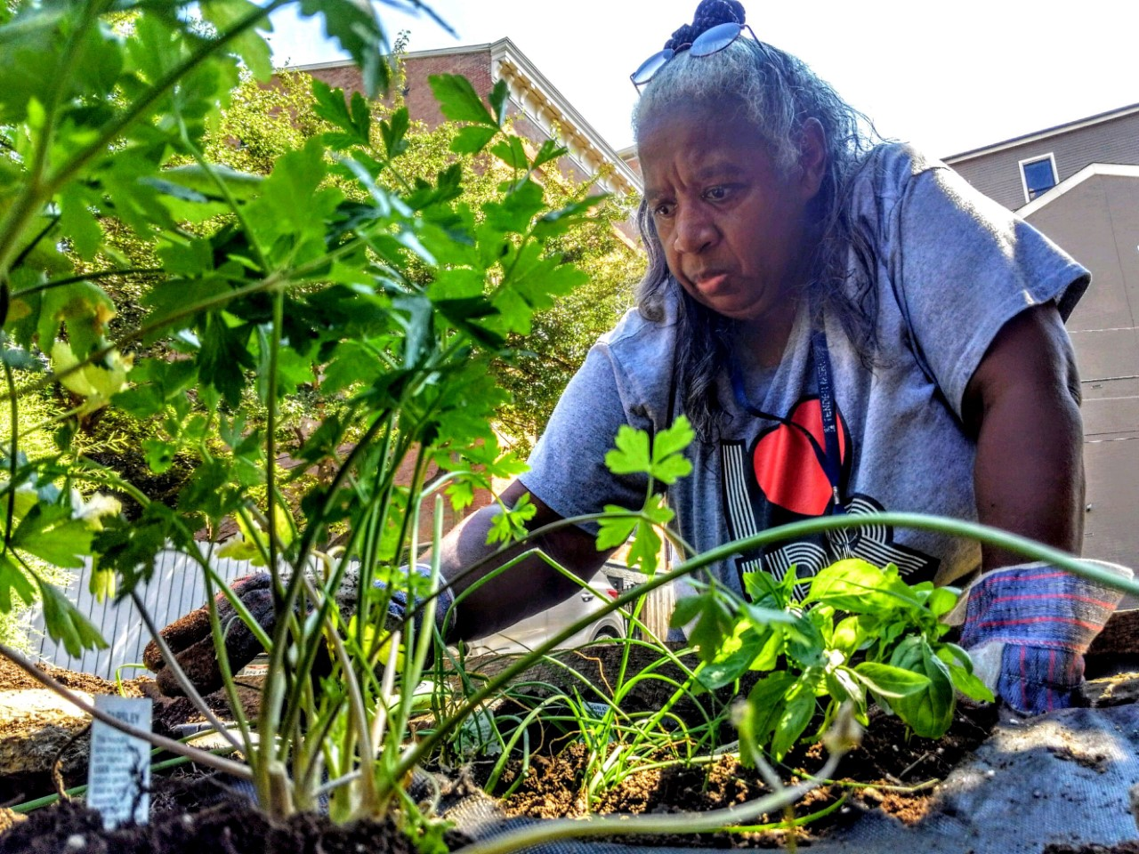
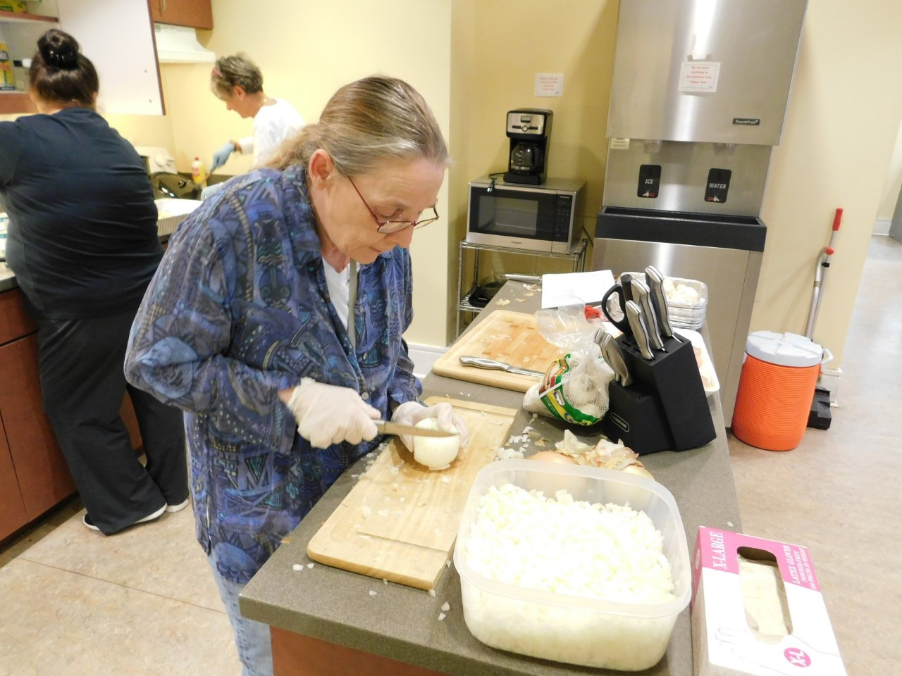
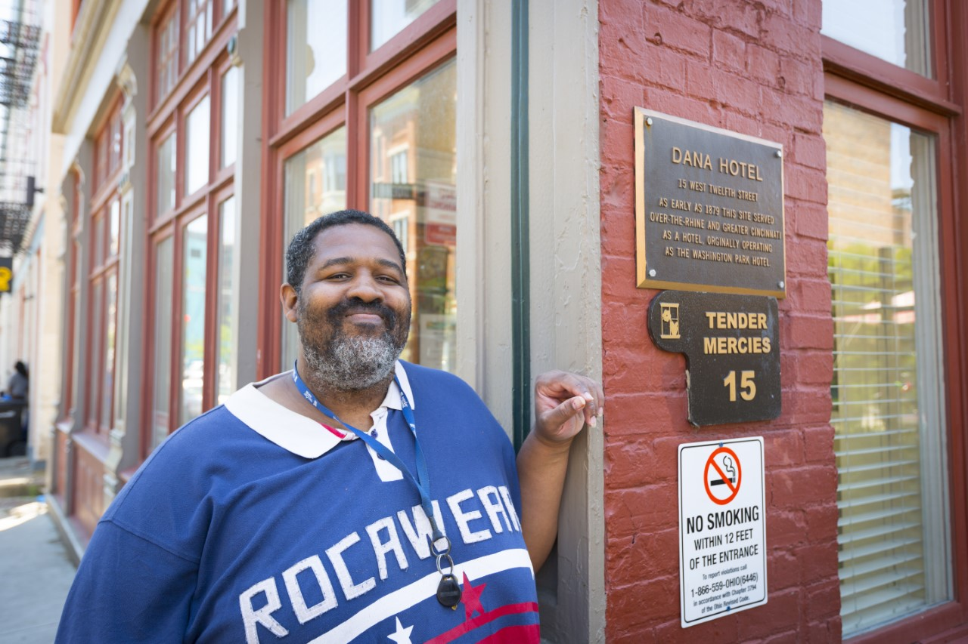



Life Enrichment and Health Maintenance in Individuals with History of Chronic Homelessness and Mood or Thought Disorders
Juliana Lavey
Urban Health Project 2019 – University of Cincinnati College of Medicine – Tender Mercies
Community Partner: Tender Mercies
Tender Mercies is a permanent supportive housing model for individuals who have been identified as both chronically homeless and suffering from a severe and persistent mood or thought disorder. In being permanent, residents can stay at Tender Mercies as long as they choose- the mean stay is four years and eight months. The housing is also supportive, where they offer a range of services from assistance with activities of daily living to support setting up Medicaid, Social Security, and more. There are six building with around 150 residents. Two more buildings are under construction.
Meet & Greet
I hosted an open meet and greet session with snacks and introductions. Here, I was able to meet several of the residents (roughly 25) and learn what I could be doing to best serve their needs. After answering several random, rapid-fire health related questions, I formulated a project vision around areas where the residents were interested. In addition to struggles with mental illness, the residents suffer from:
Hypertension
Diabetes
Obesity
Chronic Stress
Project Vision
In order to address these four major health concerns, my project was divided up into four areas of focus:
Nutrition and Dietary Management of Chronic Disease
Exercise and Weight Loss
Stress Management
Health Maintenance and Education
Nutrition and Dietary Management of Chronic Disease
In partnership with Kroger, Tender Mercies has received funding through a Keys to Health grant to teach residents cooking skills and healthy eating tips. I assisted with one of these large-scale cooking events and offered a few additional events:
Diet & Diabetes: When and What to Eat
Reading Nutrition Facts Labels
Teaching Kitchen: Cooking for Hypertension
Exercise and Weight Loss
Several sessions were offered on introductory exercise routines and tips on weight management. Such events were:
Beginner’s Chair Yoga
Starting an Exercise Program from Scratch
In addition, I used my project grant money to purchase a bariatric scale for open resident use. Typical home scales only go up to about 250 or 300 pounds. If residents are able to track their weight, I hypothesize they will be more motivated to lose weight. Using this new scale, my first resident weight-in came in at 495 pounds, immediately justifying the purchase of the new scale.
Stress Management
Many residents report high levels of baseline stress. In order to address this, I offered several events for stress-relief.
Painting and Aromatherapy
Mindful Walk in Washington Park
Decorating Signs for the Tender Mercies Garden
Introduction to Mindfulness
Coloring in Harkavy Lobby
Building Resilience: Five Tips for Promoting Happiness
Start a Journal
Dance Party: Zumba Competition and Prizes
Health Maintenance and Education
Offering opportunities for residents to advocate for their own health was important to me. Providing the weight scale as well as a glucometer for Tender Mercies allowed me to encourage residents to check blood sugars and track weight loss.
Encouraging Blood Glucose Checks
Hosting Weigh Ins
Learning Hour: All About Hypertension
Positive Presence
At the beginning of my time at Tender Mercies, my supervisor informed me that residents have a lot of people coming in and out of their lives: case workers, volunteers, counselors, and others. This revolving door of people can be very difficult, especially given the residents’ histories of mental illness, it can affect the ways they form attachments. They are often not given formal introductions, the opportunity to form solid relationships, or the chance to say goodbye when those relationships meet their natural end.
So, in part, my consistent presence at Tender Mercies was a benefit in and of itself. I would sit and chat with residents, offer good mornings and well-wishes, and practice maintaining a professional relationship with them. Also, by offering an introductory Meet & Greet and a final Send-Off Party, my site supervisor emphasized this as allowing residents to have a clear beginning and end to a relationship.
Active Listening and Learning
A significant part of my contribution this summer was bwing available to chat, listen, and answer basic health questions. Many of the events listed under “stress management” also doubled as an opportunity to sit with and listen to the residents, getting to know each of their stories.
There was a mutual benefit for both myself and the residents as I made myself available to hear stories and chat with them. I learned more than I ever could have anticipated about the life of a low-income individual in downtown Cincinnati. I heard in detail what it is like living in the mind of a person with schizophrenia or bipolar disorder. Many residents looked forward to telling me stories, and I looked forward to listening with an open mind and heart.
Conclusion
The residents of Tender Mercies are a unique vulnerable population in that they all have suffered from chronic homelessness and struggle with some form of severe and persistent mental illness. Like many Americans, the residents also suffer from diabetes, hypertension, obesity, and chronic stress. My project looked at several ways to address these issues while leaving the residents with lasting ways they can pursue their own health.
Special Thanks
I would like to offer special thanks to the following employees of Tender Mercies:
Mary Grover, my site supervisor, for her continual guidance, education, and advice. She helped me feel at home at Tender Mercies and was my major point of contact throughout the summer. This project was made possible by her support.
Rudy Frank, the volunteer coordinator, for his helpful wisdom and guidance, as well as assisting with publicizing my events and offering support as needed.
The Spaeth & Kelly basement staff for keeping me laughing!
Isaiah Noel and Namratha Kolur, our UHP co-directors, for their positive, enthusiastic attitudes and leadership!

